Slide 1
Dhanaja S B.Tech AI&DS SINCET
Naan Mudhalvan Project

Slide 2

Stock Market Prediction using LSTM

Slide 3


AGENDA
Introduction to Stack Prediction
Overview of Recurrent Neural Networks (RNN)
Understanding Long Short-Term Memory (LSTM) Networks
Data Preparation for Stack Prediction
Building and Training RNN Model for Stack Prediction
Building and Training LSTM Model for Stack Prediction
Performance Evaluation and Comparison
Conclusion and Future Directions
3/21/2024 Annual Review

Slide 4

PROBLEM STATEMENT
Develop an algorithm for predicting stack overflow occurrences in software applications, aiming to proactively identify potential stack overflow errors during runtime. The algorithm should analyze the program's control flow, memory usage, and stack frame sizes to forecast when a stack overflow is likely to happen, allowing for preemptive measures to be taken to prevent runtime crashes and improve application stability.

Slide 5

PROJECT OVERVIEW
In this project we are going to do uni variate method of analysis. We'll use only the close parameter of the data to predict the next data.
We are going to apply RNN recurrent neural network or LSTM (Long short term memory) which is very useful for the time series analysis.
We are going to find the pattern for the close price of the data

Slide 6

WHO ARE THE END USERS?
Finance and Investment Firms
E-commerce Platforms
Healthcare Industry
Manufacturing Sector
Telecommunications Companies
Marketing and Advertising Agencies
Insurance Companies
Environmental Science
Human Resources and Recruitment
Sports Analytics

Slide 7
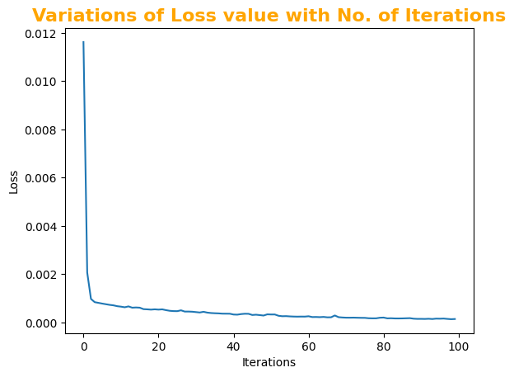
YOUR SOLUTION AND ITS VALUE PROPOSITION
Creating LSTM model:

Slide 8
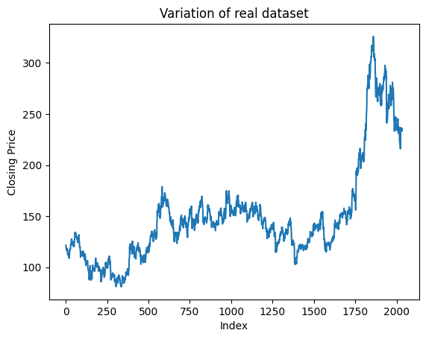
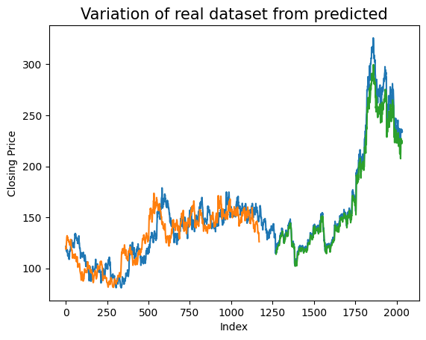
THE WOW IN YOUR SOLUTION
Visualization of comparison:
8

Slide 9
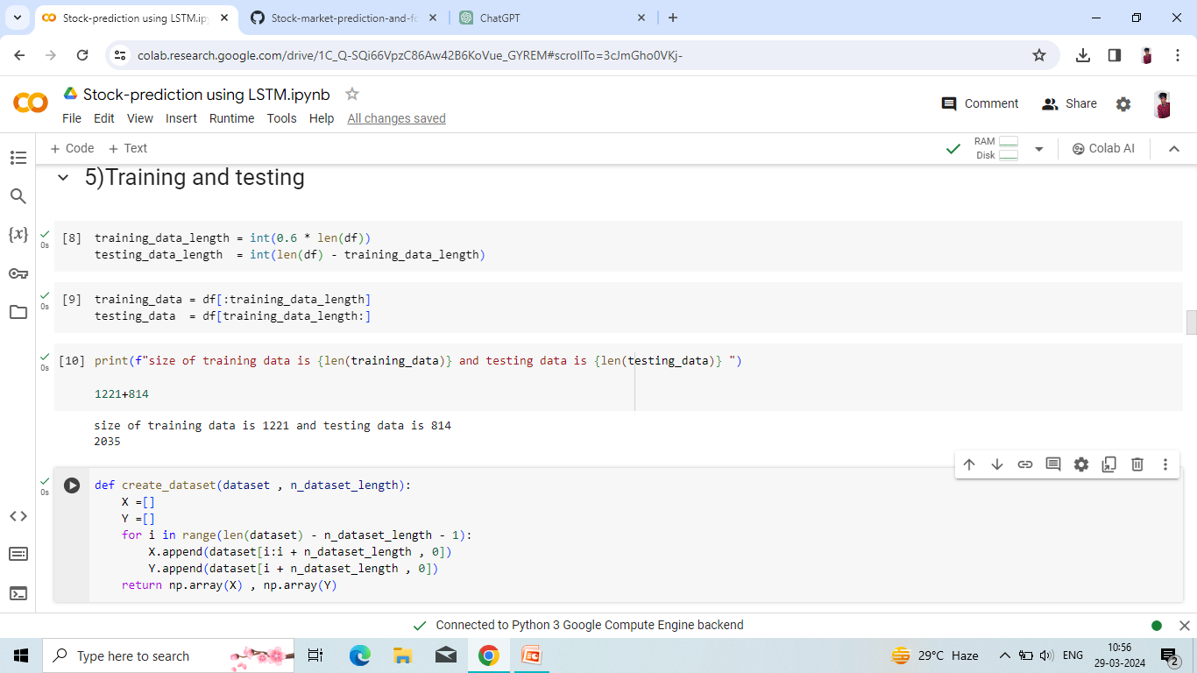
MODELLING
Split your dataset into training, validation, and testing sets.
Train your chosen model on the training set and tune hyperparameters using the validation set.
Evaluate the model's performance on the testing set using appropriate metrics such as accuracy, precision, recall, F1-score, etc.
9

Slide 10
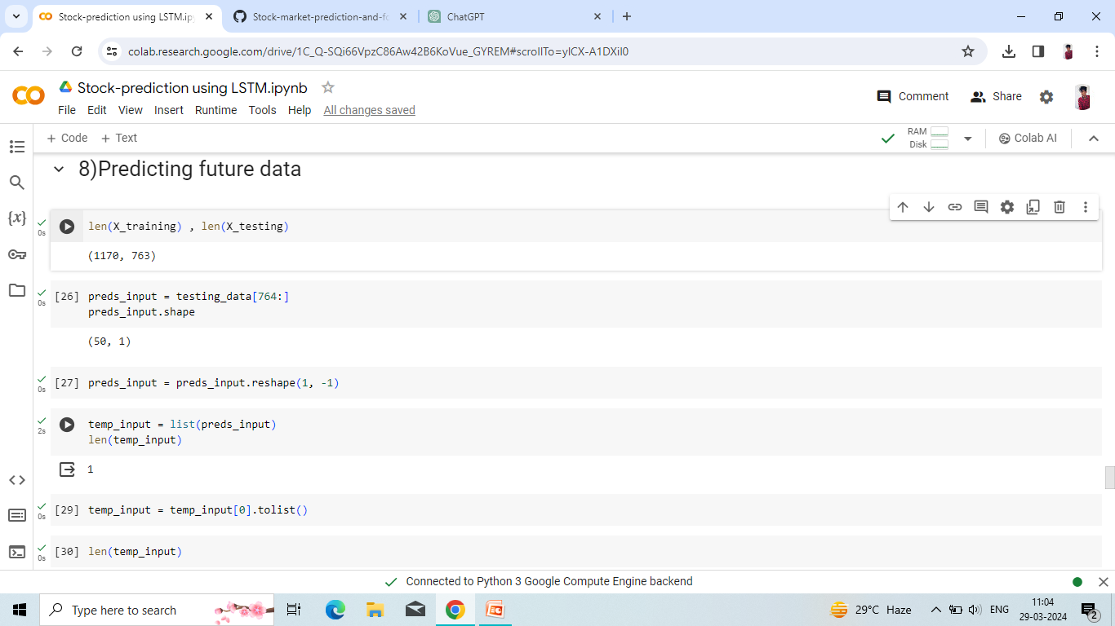
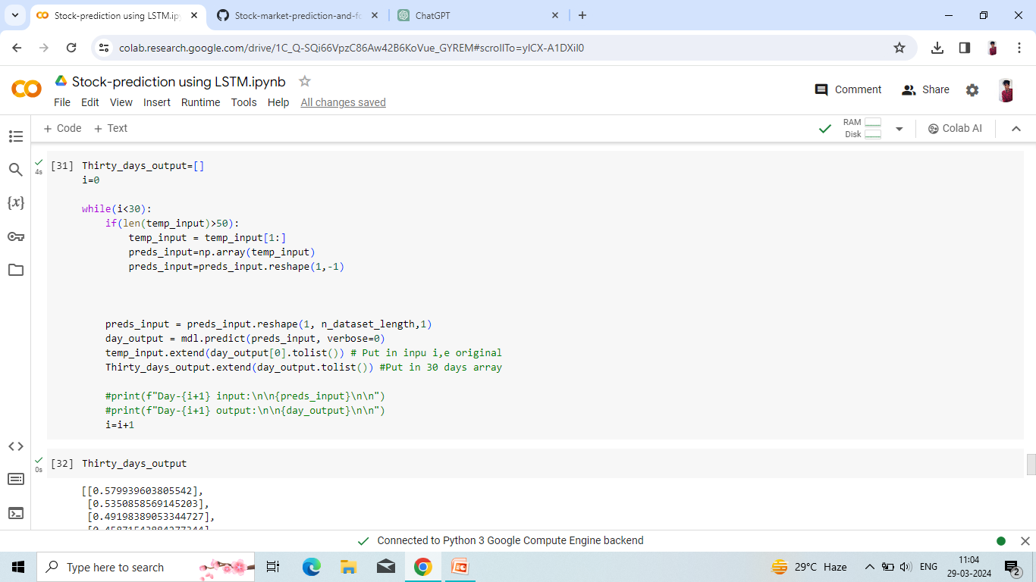
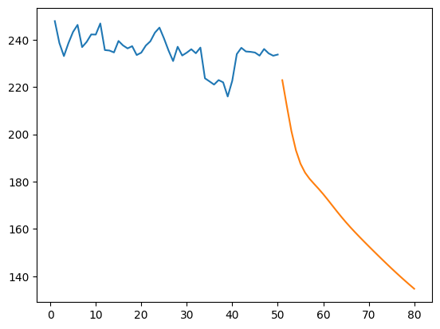
RESULTS
Predicting future data
Predicted plot →
10

